Slide 1
MTA Exploratory Data analysis : Severe Storm Events 2021
Amy Kim

Slide 2
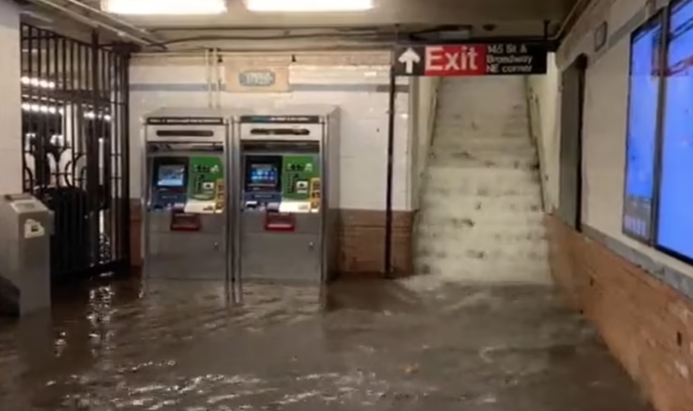
Introduction
Motivation:
City of New York experienced water inundation at various subway stations in 2021
Objectives and Goals:
Investigate patterns in passenger movement in severe storm events
Provide data to assist the City of New York in effective deployment of resources
Target stations for infrastructure upgrade
145 Street station – Hurricane Ida

Slide 3
Methodology
Data | Metrics | Tools
MTA Turnstile data NOOA Daily Precipitation Data MeteoStat Hourly Precipitation Data NYC Stormwater Flood Map NY State Subway Location Data | Correlation between rain and entries/exits at stations Movement of turnstile entries/exits between no precipitation day vs. severe storm day | SQL Alchemy Pandas NumPy Matplotlib Seaborn GeoPandas & Contextily

Slide 4
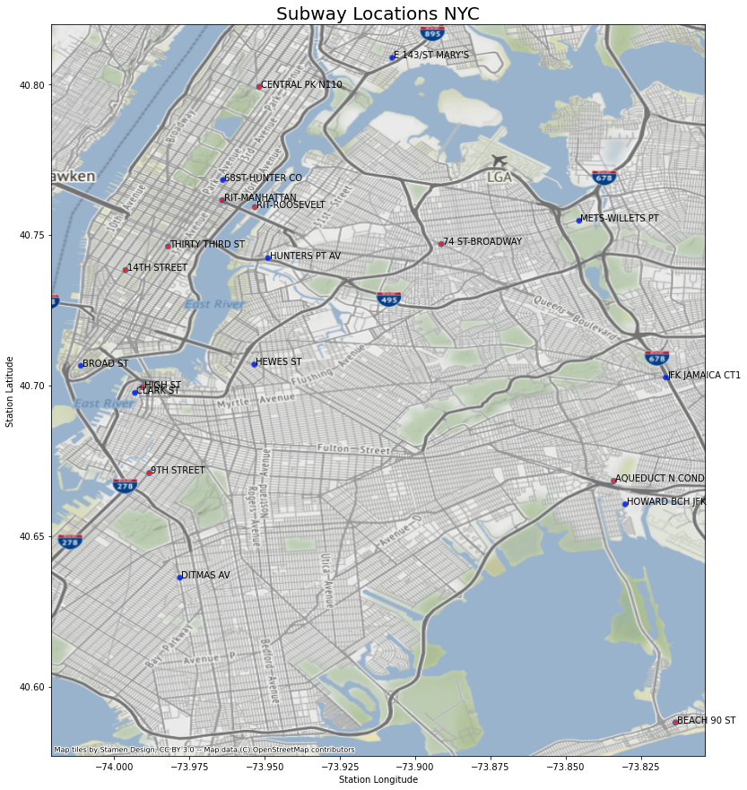
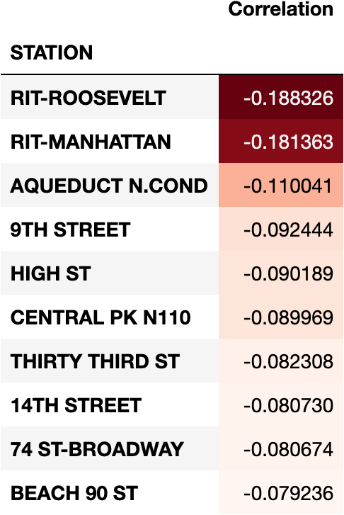
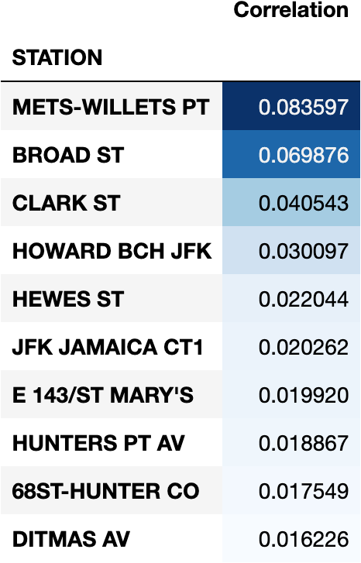
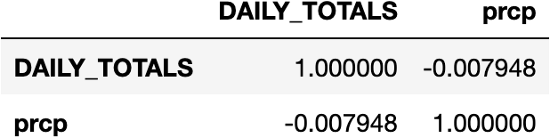
Results
Overall correlation
Top 10 negative correlations Top 10 positive correlations
Overall slight negative correlation between precipitation and total entries/exits at a station
Slightly stronger negative correlations than positive correlations, at a station level

Slide 5
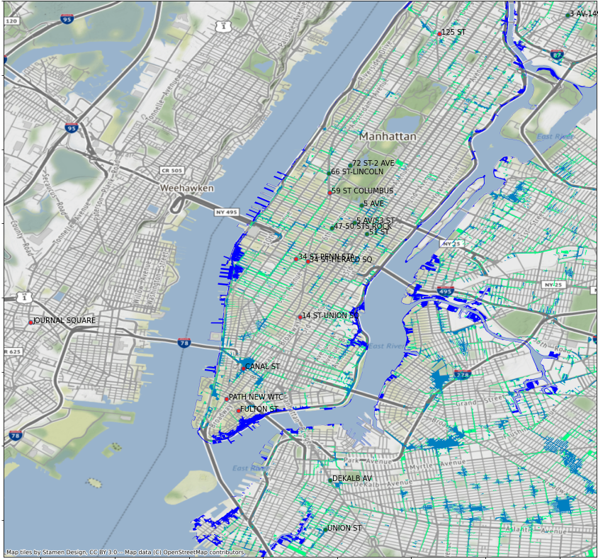
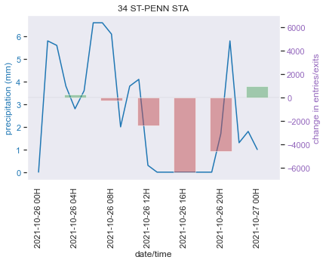
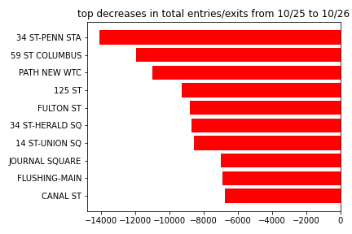
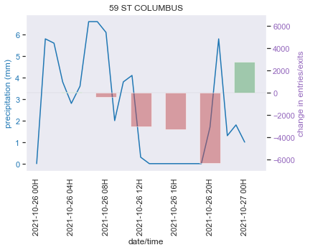
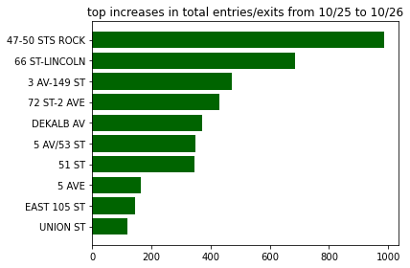
Tuesday October 26th Storm Day
Deep dive into storm days
Storm day was preceded by a day with no precipitation, so the 25th was used as a baseline for comparison.

Slide 6
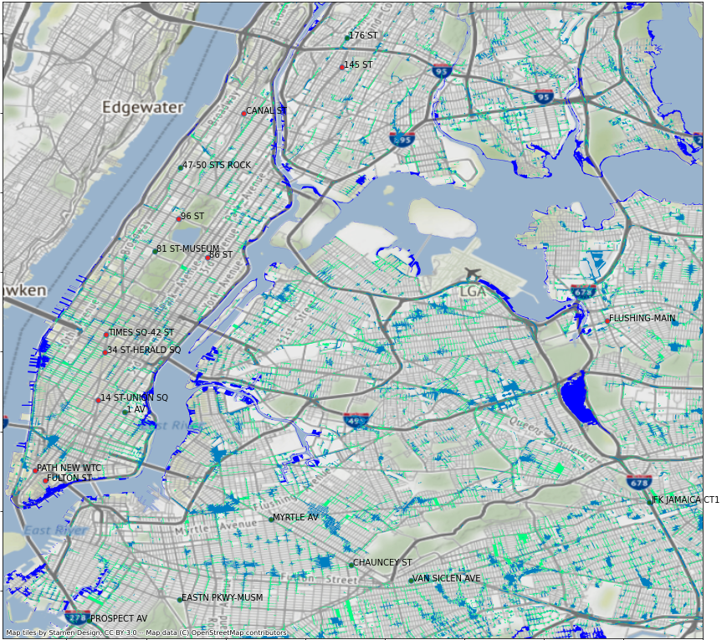
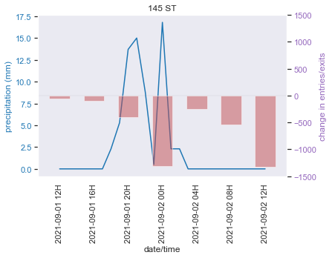
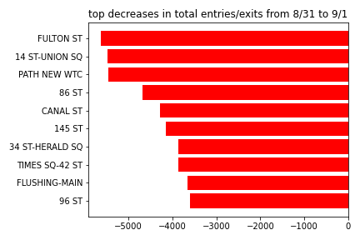
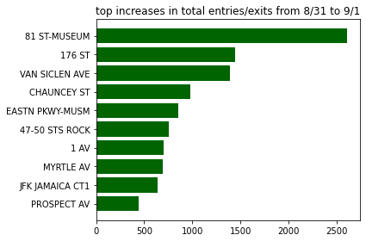
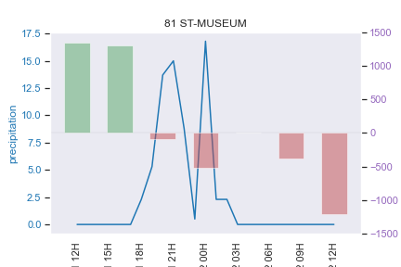
Wednesday September 1st Hurricane Ida
Big drops in entries/exits across all main subway stations
Increases at certain stations, mostly further out in the boroughs
Known flooding at 145 Street reflected in the data

Slide 7
CONCLUSION
Slight negative overall correlation between rides and precipitation
Main passenger hubs were most impacted by storms
145 Street Station which was known to be flooded was supported by the data and looking into station upgrade is recommended
FUTURE WORK:
Further research into turnstile level data. Are there particular entrances which are being more impacted than others due to location or elevation?
Look at recovery rates after a storm - how quickly does each station resume to normal passenger levels.
Targeted upgrade for those stations which have slow recovery rate.
Investigate other storm days in prior years, do we see recurring stations?

